Slide 1
UNIT 2
Context Free Grammars

Slide 2
Context-Free Grammar Introduction
Definition: A context-free grammar (CFG) consisting of a finite set of grammar rules is a quadruple (N, T, P, S) where
N is a set of non-terminal symbols.
T is a set of terminals where N ∩ T = NULL.
P is a set of rules, P: N → (N U T)*, i.e., the left-hand side of the production rule P does have any right context or left context.
S is the start symbol.
Example :
The grammar ({A}, {a, b, c}, P, A), P : A → aA, A → abc.
The grammar ({S, a, b}, {a, b}, P, S), P: S → aSa, S → bSb, S → ε The grammar ({S, F}, {0, 1}, P, S), P: S → 00S | 11F, F → 00F | ε

Slide 3
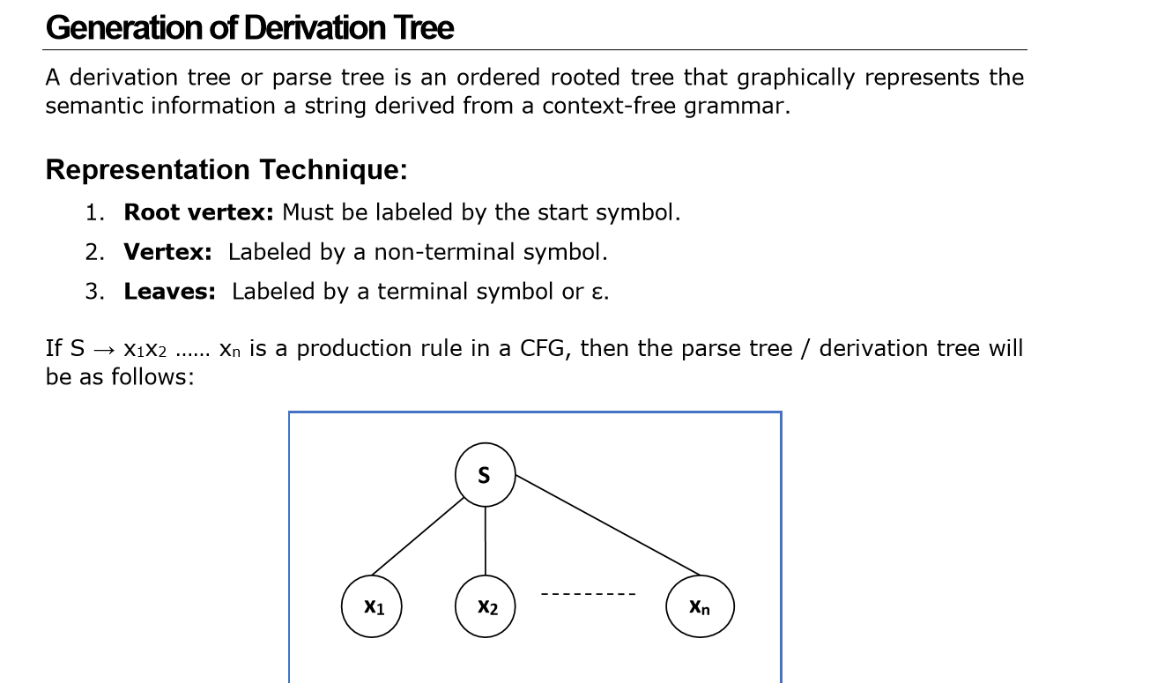

Slide 4
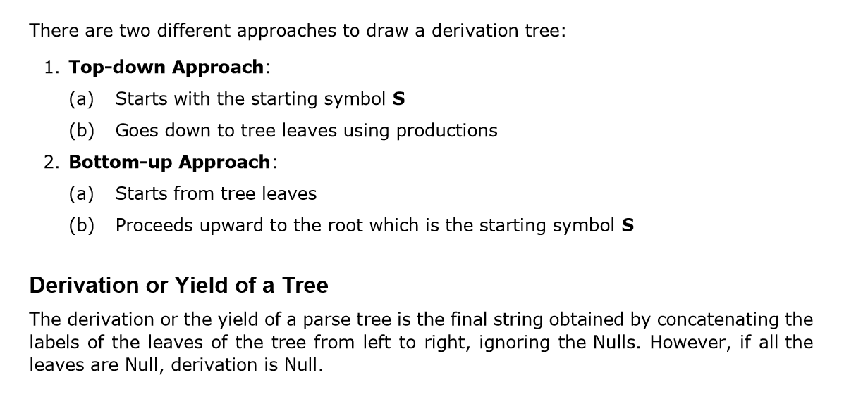

Slide 5
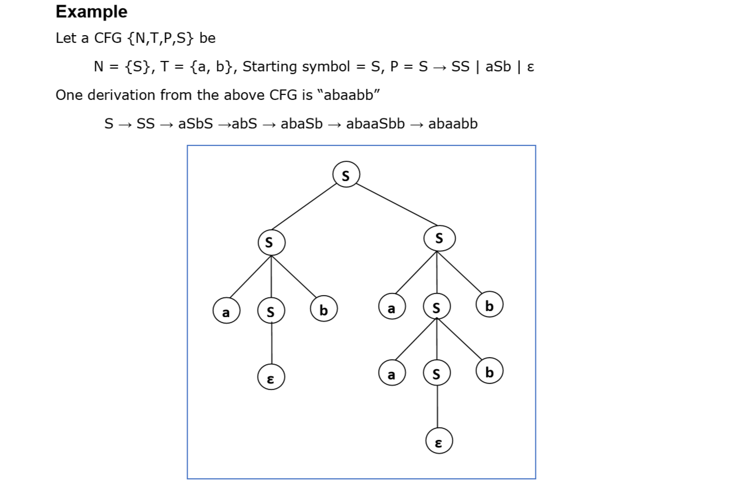

Slide 6
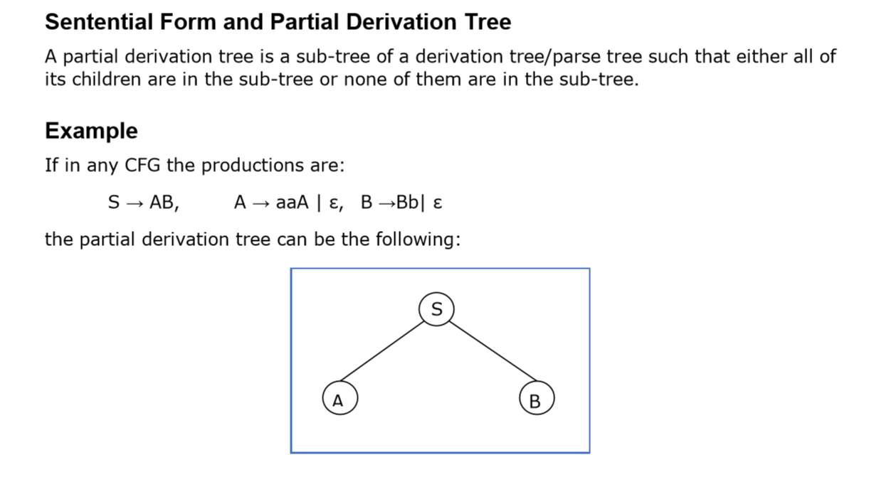

Slide 7
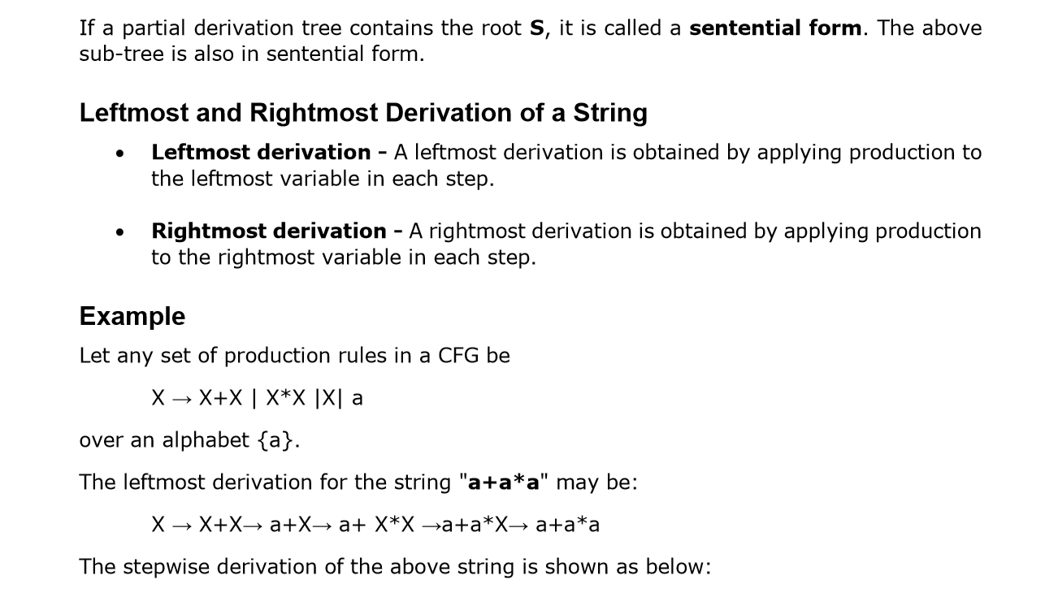

Slide 8
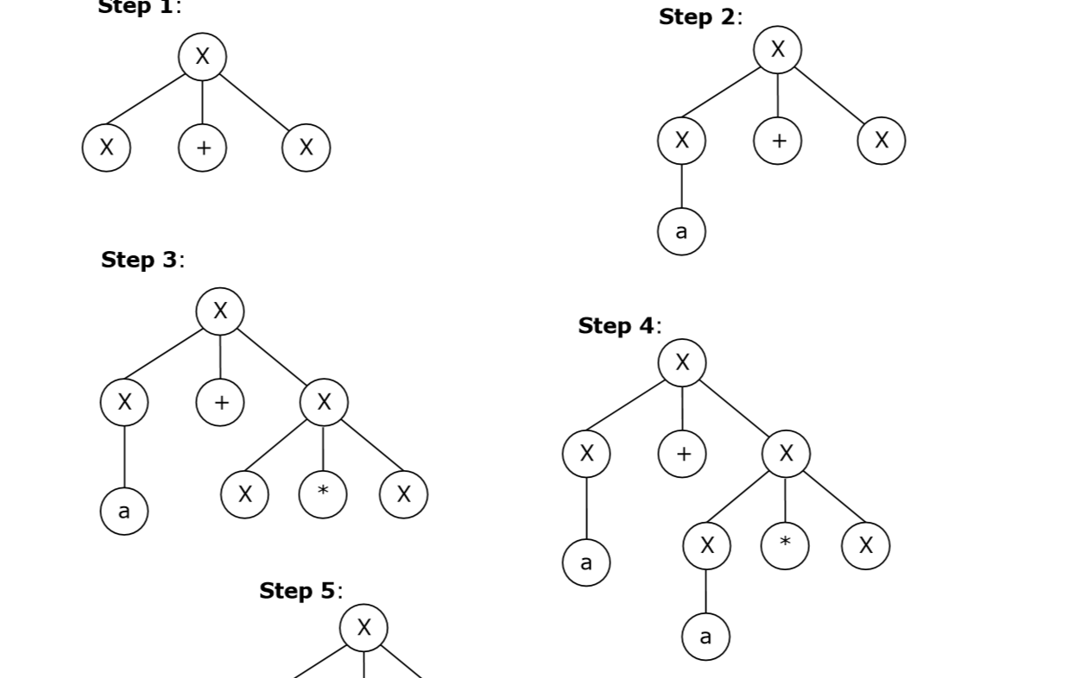

Slide 9
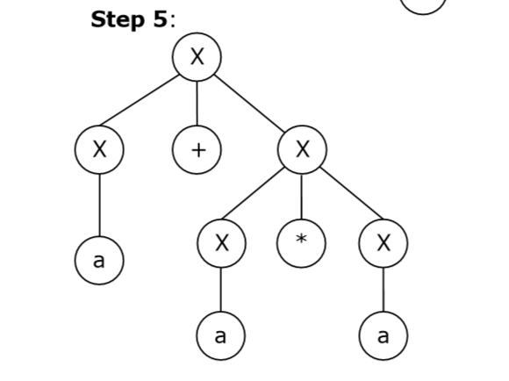
2)The rightmost derivation for the above string "a+a*a" may be:
X → X*X→ X*a → X+X*a →X+a*a→ a+a*a

Slide 10
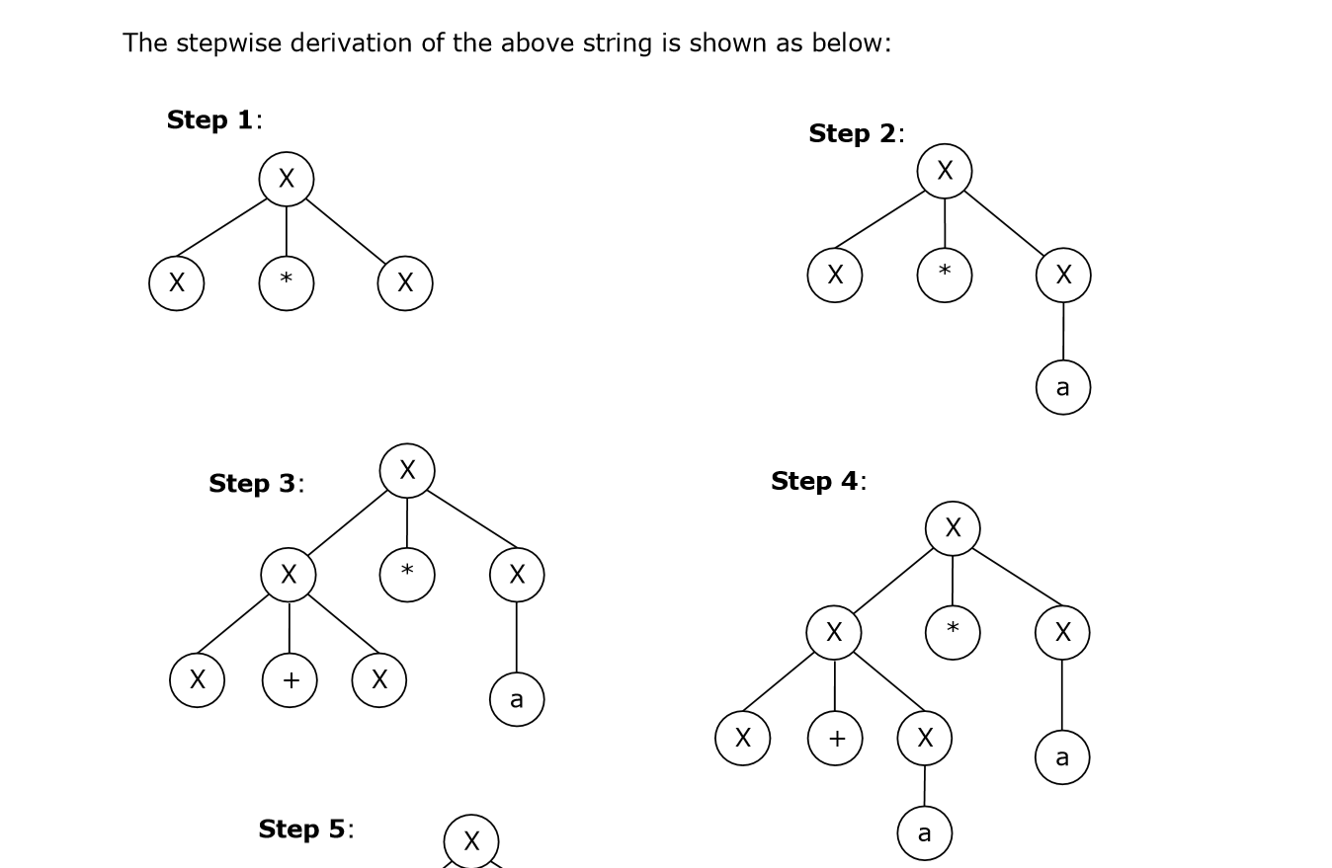

Slide 11
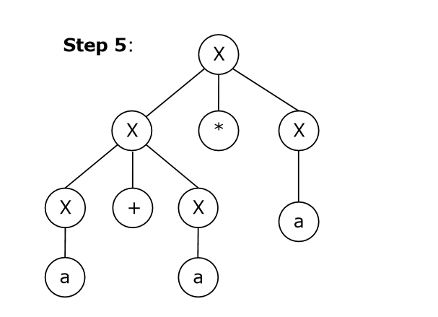
Left and Right Recursive Grammars :In a context-free grammar G, if there is a production in the form X → Xa where X is a non-terminal and ‘a’ is a string of terminals, it is called a left recursive production. The grammar having a left recursive production is called a left recursive grammar.
And if in a context-free grammar G, if there is a production is in the form X → aX where X is a non-terminal and ‘a’ is a string of terminals, it is called a right recursive production. The grammar having a right recursive production is called a right recursive grammar.

Slide 12
CFG Simplification
Removal of Unit Productions: Any production rule in the form A → B where A, B ∈ Non-terminal is called unit production.
Removal Procedure:
Step 1: To remove A→B, add production A→x to the grammar rule whenever B→x occurs in the grammar. [x ∈ Terminal, x can be Null]
Step 2: Delete A→B from the grammar.
Step 3: Repeat from step 1 until all unit productions are removed.

Slide 13
Problem: Remove unit production from the following:
S → XY, X → a, Y → Z | b, Z → M, M → N, N → a
Solution:
There are 3 unit productions in the grammar:
Y → Z, Z → M, and M → N
i)At first, we will remove M → N.
As N → a, we add M → a, and M → N is removed.
The production set becomes
S → XY, X → a, Y → Z | b, Z → M, M → a, N → a

Slide 14
ii) Now we will remove Z → M.
As M → a, we add Z→ a, and Z → M is removed.
The production set becomes
S → XY, X → a, Y → Z | b, Z → a, M → a, N → a
iii)Now we will remove Y → Z.
As Z → a, we add Y→ a, and Y → Z is removed.
The production set becomes
S → XY, X → a, Y → a | b, Z → a, M → a, N → a
Now Z, M, and N are unreachable, hence we can remove those.
The final CFG is unit production free:
S → XY, X → a, Y → a | b

Slide 15
2) Removal of Null Productions: In a CFG, a non-terminal symbol ‘A’ is a nullable variable if there is a production A → ϵ or there is a derivation that starts at A and finally ends up with
ϵ: A → .......… → ϵ
Removal Procedure:
Step1 Find out nullable non-terminal variables which derive ϵ.
Step2 For each production A → a, construct all productions A → x where x is obtained from ‘a’ by removing one or multiple non-terminals from Step 1.
Step3 Combine the original productions with the result of step 2 and remove ϵproductions.

Slide 16
Problem: Remove null production from the following:
S→ASA | aB | b, A → B, B → b | ϵ
Solution:
There are two nullable variables: A and B
At first, we will remove B → ϵ.
After removing B → ϵ, the production set becomes:
S→ASA | aB | b | a, A → B| b | ϵ, B → b
ii) Now we will remove A → ϵ.
After removing A → ϵ, the production set becomes:
S→ASA | aB | b | a | SA | AS | S, A → B| b, B → b
This is the final production set without null transition.

Slide 17
Chomsky Normal Form
A CFG is in Chomsky Normal Form if the Productions are in the following forms:
A → a
A → BC
S → ϵ
where A, B, and C are non-terminals and a is terminal.

Slide 18
Algorithm to Convert into Chomsky Normal Form:
Step 1 : If the start symbol S occurs on some right side, create a new start symbol S’ and a new production S’ → S.
Step 2 : Remove Null productions. (Using the Null production removal algorithm discussed earlier)
Step 3 : Remove unit productions. (Using the Unit production removal algorithm discussed earlier)
Step 4 : Replace each production A → B1…Bn where n > 2 with A → B1C where C → B2 …Bn. Repeat this step for all productions having two or more symbols in the right side.
Step 5 : If the right side of any production is in the form A→ aB where a is a terminal and A, B are non-terminal, then the production is replaced by A→ XB and X→ a. Repeat this step for every production which is in the form A→ aB.

Slide 19
Problem: Convert the following CFG into CNF
S→ ASA | aB, A → B | S, B → b | ϵ
Solution:
(1) Since S appears in R.H.S, we add a new state S0 and S0→S is added to the production set and it becomes:
S0→S, S→ ASA | aB, A → B | S, B → b | ϵ
(2) Now we will remove the null productions:
B → ϵ and A → ϵ
After removing B → ϵ, the production set becomes:
S0→S, S→ ASA | aB | a, A → B | S | ϵ, B → b
After removing A → ϵ, the production set becomes:
S0→S, S→ ASA | aB | a | AS | SA | S, A → B | S, B → b

Slide 20
(3) Now we will remove the unit productions.
After removing S→ S, the production set becomes:
S0→S, S→ ASA | aB | a | AS | SA, A → B | S, B → b
After removing S0→ S, the production set becomes:
S0→ ASA | aB | a | AS | SA, S→ ASA | aB | a | AS | SA
A → B | S, B → b
After removing A→ B, the production set becomes:
S0 → ASA | aB | a | AS | SA, S→ ASA | aB | a | AS | SA
A → S | b
B → b
After removing A→ S, the production set becomes:
S0 → ASA | aB | a | AS | SA, S→ ASA | aB | a | AS | SA
A → b |ASA | aB | a | AS | SA, B → b

Slide 21
(4) Now we will find out more than two variables in the R.H.S
Here, S0→ ASA, S → ASA, A→ ASA violates two Non-terminals in R.H.S.
Hence we will apply step 4 and step 5 to get the following final production set which is in CNF:
S0→ AX | aB | a | AS | SA
S→ AX | aB | a | AS | SA
A → b |AX | aB | a | AS | SA
B → b
X→ SA
(5) We have to change the productions S0→ aB, S→ aB, A→ aB
And the final production set becomes:
S0→ AX | YB | a | AS | SA
S→ AX | YB | a | AS | SA
A → b |AX | YB | a | AS | SA
B → b
X→ SA
Y → a

Slide 22
Greibach Normal Form
A CFG is in Greibach Normal Form if the Productions are in the following forms:
A → b
A → bD1…Dn
S → ϵ where A, D1,....,Dn are non-terminals and b is a terminal.
Algorithm to Convert a CFG into Greibach Normal Form:
Step 1 If the start symbol S occurs on some right side, create a new start symbol S’ and a new production S’ → S.
Step 2 Remove Null productions. (Using the Null production removal algorithm discussed earlier)
Step 3 Remove unit productions. (Using the Unit production removal algorithm discussed earlier)
Step 4 Remove all direct and indirect left-recursion.
Step 5 Do proper substitutions of productions to convert it into the proper form of GNF.

Slide 23
Problem: Convert the following CFG into CNF
S→ XY | Xn | p
X → mX | m
Y → Xn | o
Solution:Here, S does not appear on the right side of any production and there are no unit or null productions in the production rule set. So, we can skip Step 1 to Step 3.
Step 4:
Now after replacing
X in S → XY | Xo | p
with
mX | m
we obtain
S → mXY | mY | mXo | mo | p.

Slide 24
And after replacing
X in Y→ Xn | o
with the right side of
X → mX | m
we obtain
Y→ mXn | mn | o.
Two new productions O→ o and P → p are added to the production set and then we came to the final GNF as the following:
S → mXY | mY | mXC | mC | p
X→ mX | m
Y→ mXD | mD | o
O → o
P → p

Slide 25
CFL Closure Property
Context-free languages are closed under:
Union
Concatenation
Kleene Star operation

Slide 26
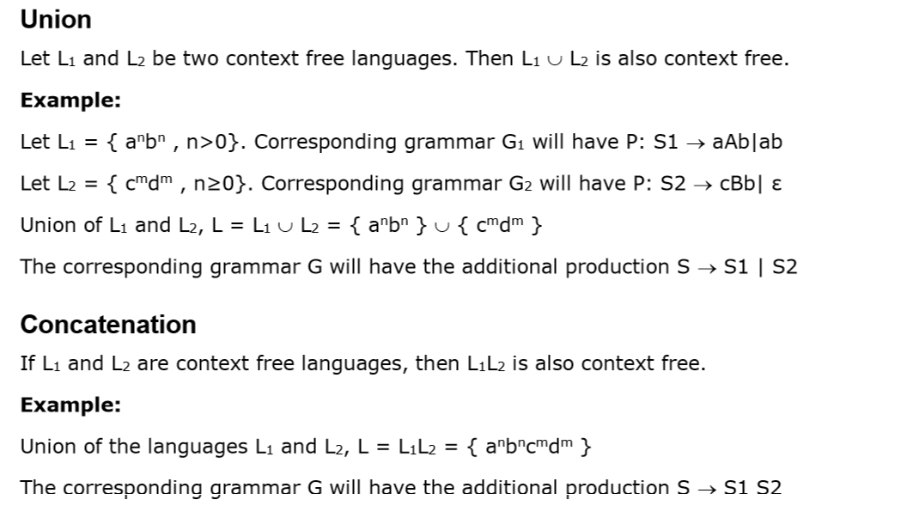

Slide 27
